Slide 1
Introductory To Programming
and
Problem-Solving Skills
Control Structures
Tutorial Week - 3
Bhisma Raj Koirala

Slide 2
Agenda
Sequential Flow
Selection control
if statement
else statement
elif statement
Nested Condition
Exercises

Slide 3
Let’s Think Conditionally!!
Let’s stay a bit differently in today’s class!!
Let’s make two groups, Team_if and Team_else
Team_if = students from alphabet A-L
Team_else = students from alphabet M-Z
Students from Team_if will sit at Left_Row and Team_else will sit at Right_Row!!
Now, think about it while making the decision first think your required was condition and second thing your required was action!! Exactly in programming conditional statements work on the same way!!

Slide 4
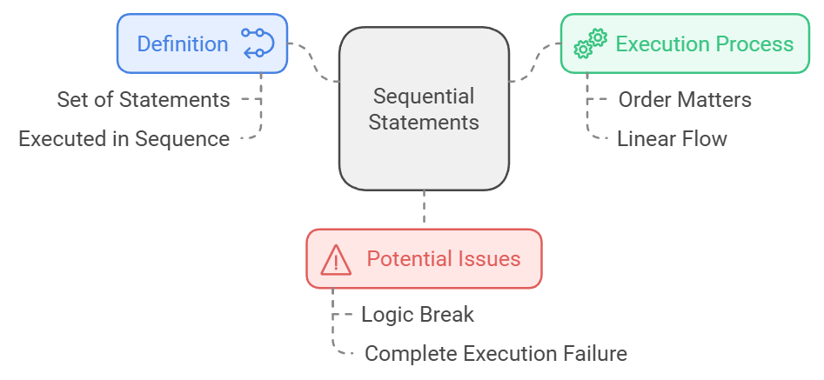
Control Flow Statements
What is sequential Flow?
Sequential statements are set of statement whose execution process happens in a sequence.

Slide 5
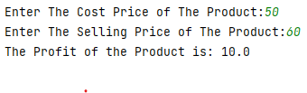
Example 1
Program to calculate profit of the product.
costPrice = float(input("Enter The Cost Price of The Product:")) sellingPrice = float(input("Enter The Selling Price of The Product:")) profit = sellingPrice - costPrice print("The Profit of the Product is:", profit)
Top to Bottom
Approach

Slide 6
For You
Develop a program which prompts user to ask the temperature in Celsius and convert that into Fahrenheit with a display message. And Explain how the flow of code is sequential. (Hint: (Celsius * 9/5) + 32)

Slide 7
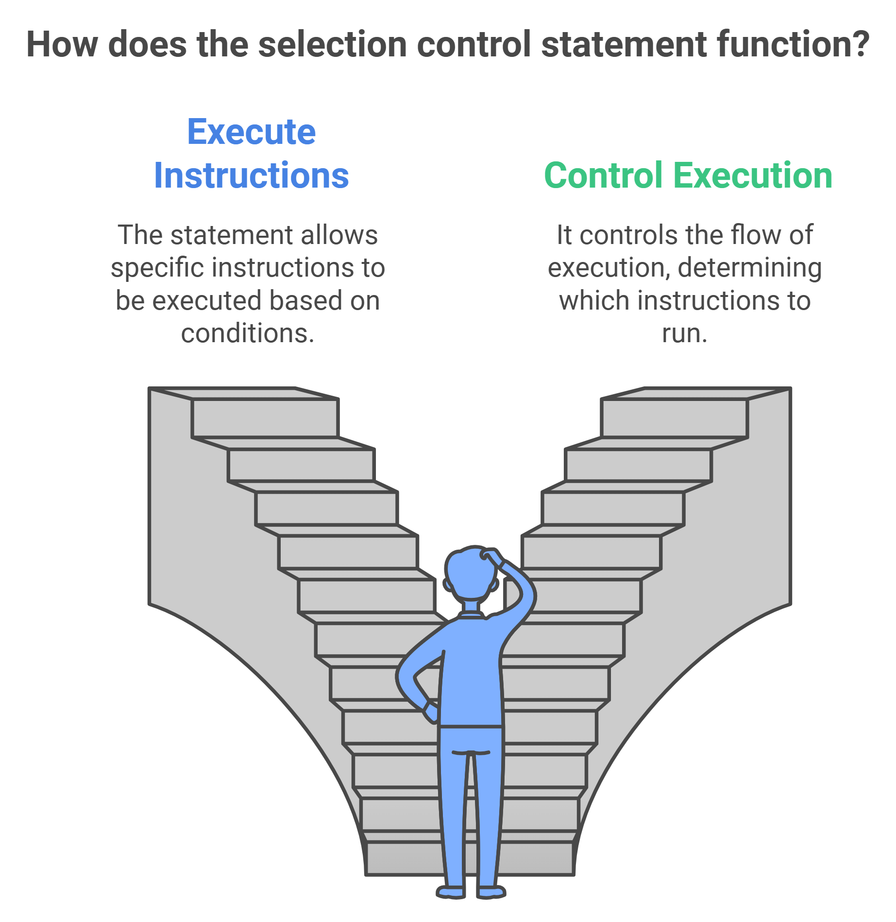
Selection Control
What is selection control?
A selection control statement is a control statement providing selective execution of instructions. There are various statements which follows selection control.

Slide 8
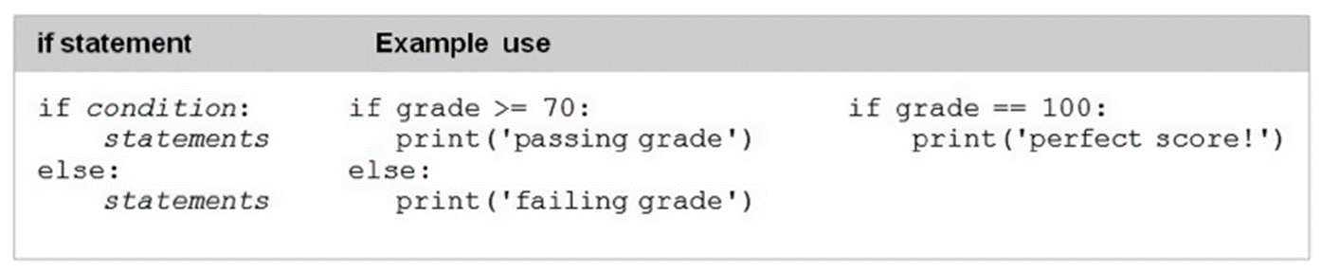
The if statement
The if statement is a conditional statement in python, that used to determine whether a block of code will be executed or not. Meaning if the program finds the condition defined in the statement to be true, it will go ahead and execute the code block inside the if statement.

Slide 9
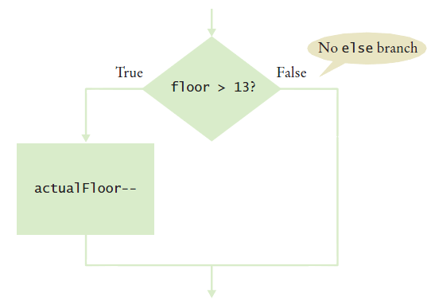
Flowchart
actualFloor = floor;
if (floor > 13):
actualFloor = actualFloor – 1

Slide 10
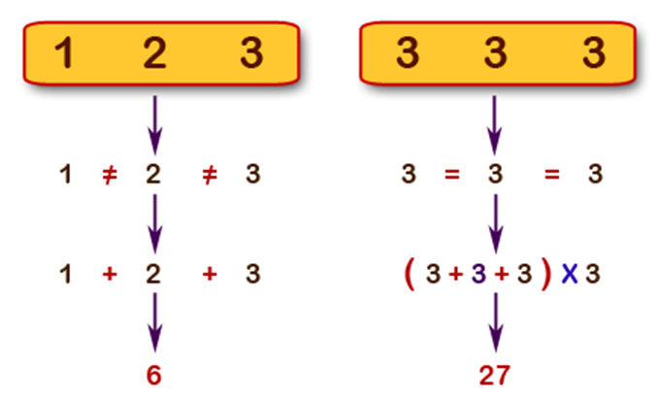
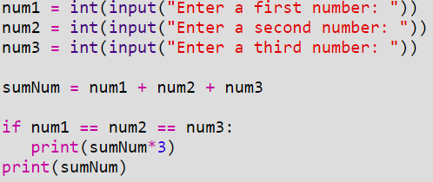
Example 2
Write a python program to calculate the sum of three given numbers. If the values are equal then print three time their sum.
You might get the output but there is a problem with this program!!! We will look into it later on.

Slide 11
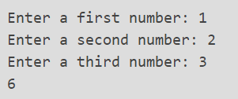
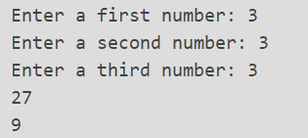
Output
When the numbers are different, the output appears correct. However, when the numbers are equal, the output might not be as expected.
THINK HOW TO FIX THIS??

Slide 12
The if - else statement
When the if statement is not true the else statement is executed. Meaning, when the if statement is false then the block of code at else is executed.

Slide 13
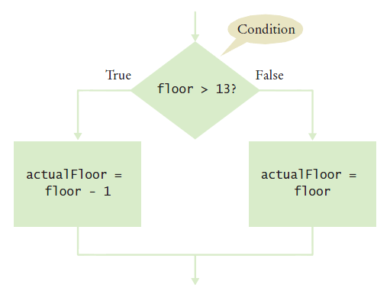
Flowchart
actualFloor = floor;
if (floor > 13):
actualFloor = actualFloor – 1
else:
actualFloor = Floor

Slide 14
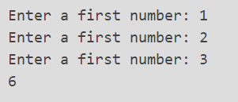
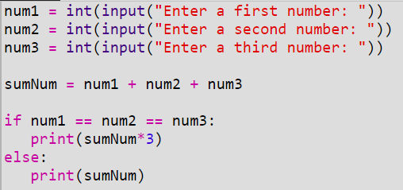
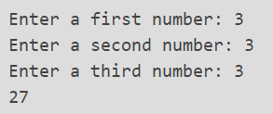
Example 3
Write a python program to calculate the sum of three given numbers. If the values are equal then print three time their sum.
When the if condition is false then else is executed.

Slide 15
For You
2. Write a python program that asks user’s input and sum three numbers. However, if two values are equal, the sum will be zero.
Hint: You might want to use logical operator.

Slide 16
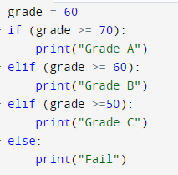
The elif statement
Whenever, there is multiple condition then elif statement is used. Meaning, when the if statement is false then elif statement is executed and when elif statement is false then else statement is executed at last.

Slide 17
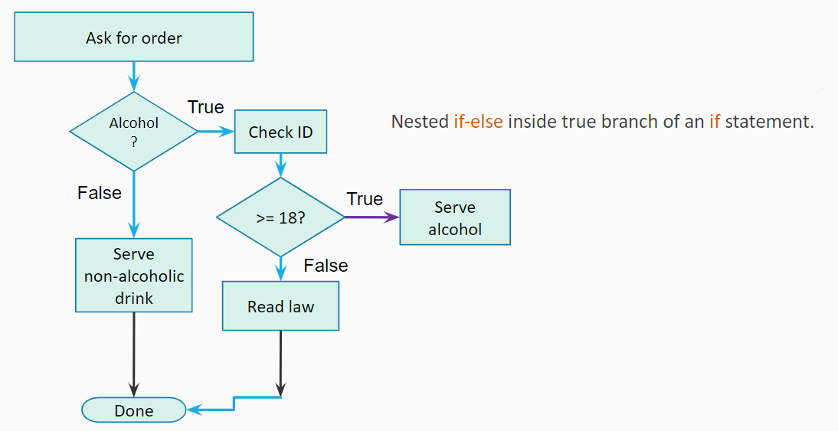
Nested condition
Nested condition refers to a situation in programming where one or more conditional statements are place inside another conditional statement.

Slide 18
For You
3. Accept any city from the user and display tourist attraction of that city.
City | Monuments
Kathmandu | Pashupatinath Temple
Pokhara | Fewa Lake
Nepalgunj | Bageshwori Temple
Birgunj | Birgunj Ghanta Ghar

Slide 19
For You
4. Write a python program that asks user’s bar order. If the order contains alcohol, the program should check the customer’s ID. If the ID states that the customer is 18 years or older, the program should display the legal drinking age law and end. If the customer is under, the program should serve non alcoholic drink and exit.

Slide 20
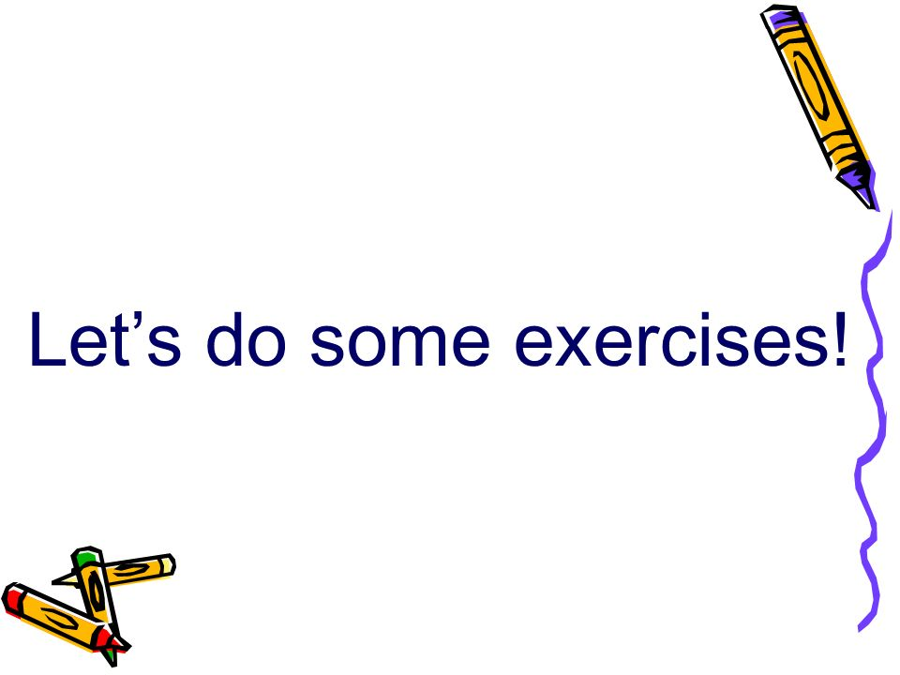

Slide 21
For You – Exercise
Program to print the positive difference of two numbers.
Write a program that accepts percentage form the user and display the grade according to the following. [Percentage and GPA should be of BIC college]
Write a program to whether a number (accepted from user) is divisible by 2 and 3 both.
Write a program that takes in two numbers and displays the product of the two numbers if both numbers are positive, otherwise it returns "Numbers must be positive".

Slide 22
For You – Additional Questions
Accept the following from the user and calculate the percentage of class attended:
Total number of working days
Total number of absent days
After calculating the percentage, if the percentage is less than 80, then students will not be able to sit the exam.
Develop a game where there is a zombie who is walking straight in the road. While moving ahead, there is a pothole where zombie might fall and die. In right hand side there is a jungle where zombie will get lost and die out of hunger or gets shot by hunter. The only way to win the game is to make zombie move left where zombie will find human.

Slide 23
For You – Home Task
You are working for a theme park. As part of the park's safety regulations, certain rides have height restrictions. Write a Python program that asks the visitor for their height. If the visitor meets the height requirement (minimum height is 120 cm), allow them to enter the ride. If the visitor is too short, inform them that they cannot enter the ride and suggest an alternative ride suitable for their height. If the visitor's input is not a valid number, display an error message and exit the program.

Slide 24


